Slide 1

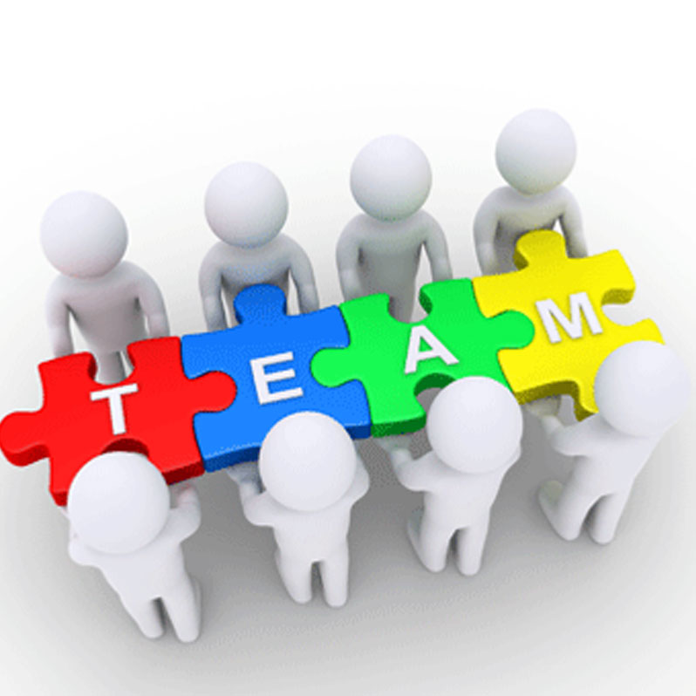
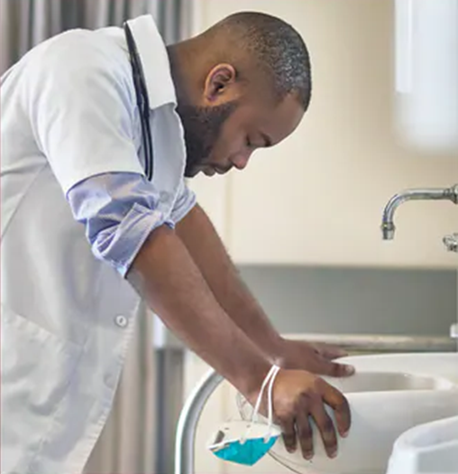

Empowering Healthcare Professionals and Teams with Well-Being Tools
Prachi Garodia M.D., ABIHM, DipABLM, NBC-HWC
Michael Spertus, M.D., ABOIM, DipABLM

Slide 2
Disclosures
Michael Spertus, M.D – None
Prachi Garodia, M.D – None
While both physicians are affiliated to Veterans Administration, the views expressed are their own subject matter expertise and do not imply an endorsement by the VA or United States Government.
Whole Health Personal inventory and planning tool used in this talk was developed by Veteran Administration’s Office of Patient-Centered Cultural Care and transformation (OPCC&CT) in partnership with Duke Integrative Medicine. It is available for public use.
Some material was developed for the HCP wellbeing course by the American College of Lifestyle Medicine with a grant from the Ardmore Institute of Health.

Slide 3

Objectives and goals
  Review Whole health person centric approach to health.
  Conduct brief flourishing and other self-assessments
  Develop individual action steps in achieving and sustaining a comprehensive healthy lifestyle, including a whole food plant-based diet, physically activity, sleep, avoidance of risky substances, stress management, and positive psychology activities
  Apply positive psychology activities in personal action plans for emotional and physical well-being
  Adopt strategies for influencing health care workplace culture to support the well-being of health teams.

Slide 4
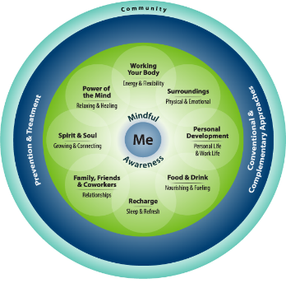
What is Whole Health?
  An approach to health care that
  Empowers & Equips
  people to take charge of their health and well-being and live life to the fullest.
  Sick Care
  “What’s the matter with you?”
  Health Care
  “What matters to you?”
Patient centered care: A path to better health outcomes through engagement and activation - PubMed
Impact of Person-Centered Interventions on Patient Outcomes in Acute Care Settings: A Systematic Review
5

Slide 5
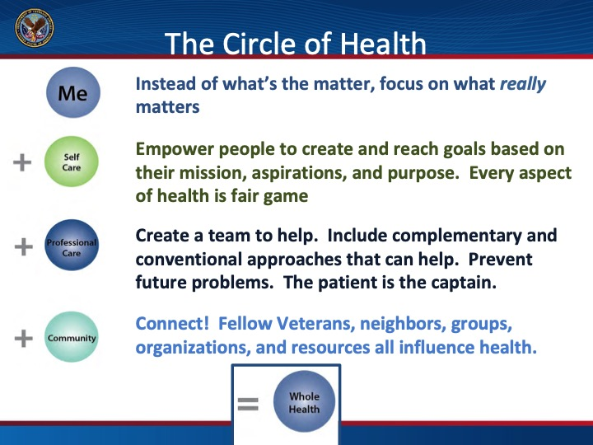

The Circle of Health: Four key elements
Me: “Me” at the center.
Self Care: the skills and support you need to make the changes you want.
Professional Care: Your health team to help with the prevention and treatment of disease and illness.
Community: “We” that enfolds it.

Slide 6

Activity 1
Conduct group brief flourishing self-assessments

Slide 7

Self-Assessment Process
Two assessments that evaluate satisfaction with life and are included here as examples.
  The Satisfaction with Life Scale is a broad assessment validated by Ed Diener and his team.

Slide 8
Satisfaction with Life Scale
Indicate below on scale of 1 (strongly disagree) to 7 (strongly agree)
____ In most ways my life is close to my ideal.
____ The conditions of my life are excellent.
____ I am satisfied with my life.
____ So far I have gotten the important things I want in life.
____ If I could live my life over, I would change almost nothing.
Diener E, Emmons RA, Larsen RJ, Griffin S. The Satisfaction with Life Scale. J Pers Assess. 1985;48(1):71-75
Kjell ONE, Diener E. Abbreviated three item version of the Satisfaction with Life Scale and the Harmony in life scale yield as strong psychometric properties as the original scales. Journal of Personality Assessment. Doi:10.1080/00223891.2020.1737093

Slide 9
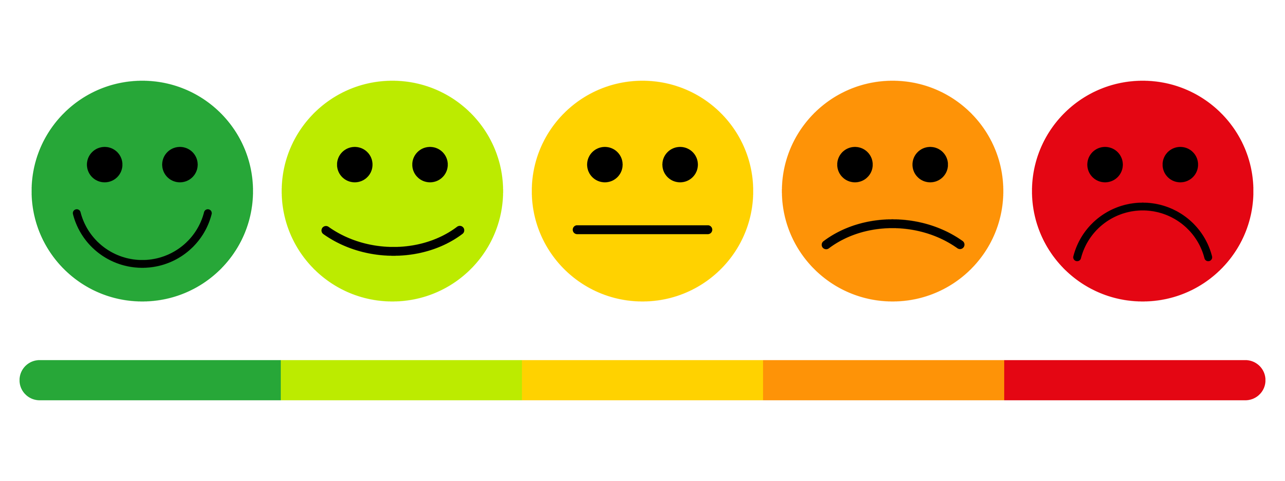
Satisfaction with Life Scale (SWLS)
Interpretation of Scores
30 - 35 Very high score; highly satisfied
25 - 29 High score
20 - 24 Average score
15 - 19 Slightly below average in life satisfaction
10 - 14 Dissatisfied
5 - 9 Extremely Dissatisfied
https://commondatastorage.googleapis.com/eddiener/uploads/support/file/10/Understanding_SWLS_Scores.pdf

Slide 10
Flourishing Scale
Using the 1-7 scale (1 strongly disagree to 7 strongly agree), indicate your agreement with each item.
____ I lead a purposeful and meaningful life.
____ My social relationships are supportive and rewarding.
____ I am engaged and interested in my daily activities.
____ I actively contribute to the happiness and well-being of others.
____ I am competent and capable in the activities that are important to me.
____ I am a good person and live a good life.
____ I am optimistic about my future.
____ People respect me.
Schotanus-Dijkstra M, Klooster PM ten, Drossaert CHC, et al. Validation of the Flourishing Scale in a sample of people with suboptimal levels of mental well-being. BMC Psychol. 2016;4:12.
Diener E, Wetz D, Trov W, et al. New measures of well-being: Flourishing and positive and negative feelings. Soc Indic Res. 2009;99:247-266.
SCORING: The greater the score, the higher your psychological resources and strengths.

Slide 11
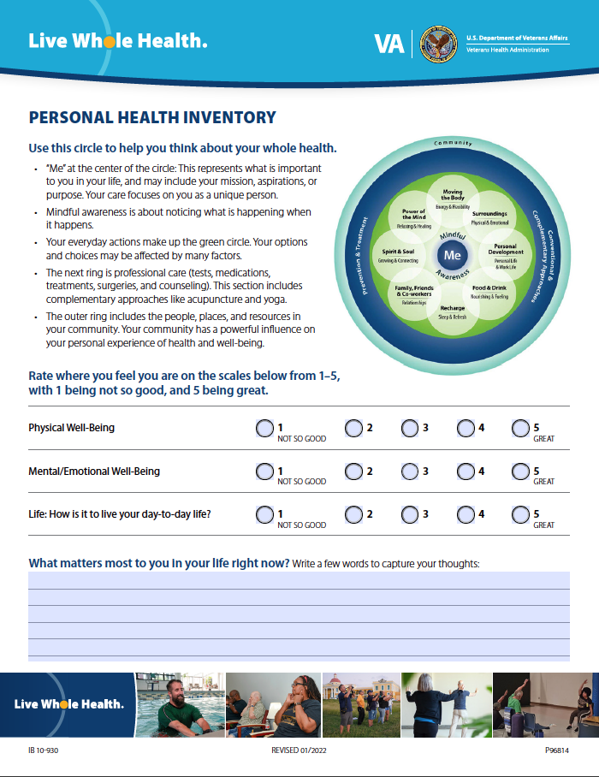
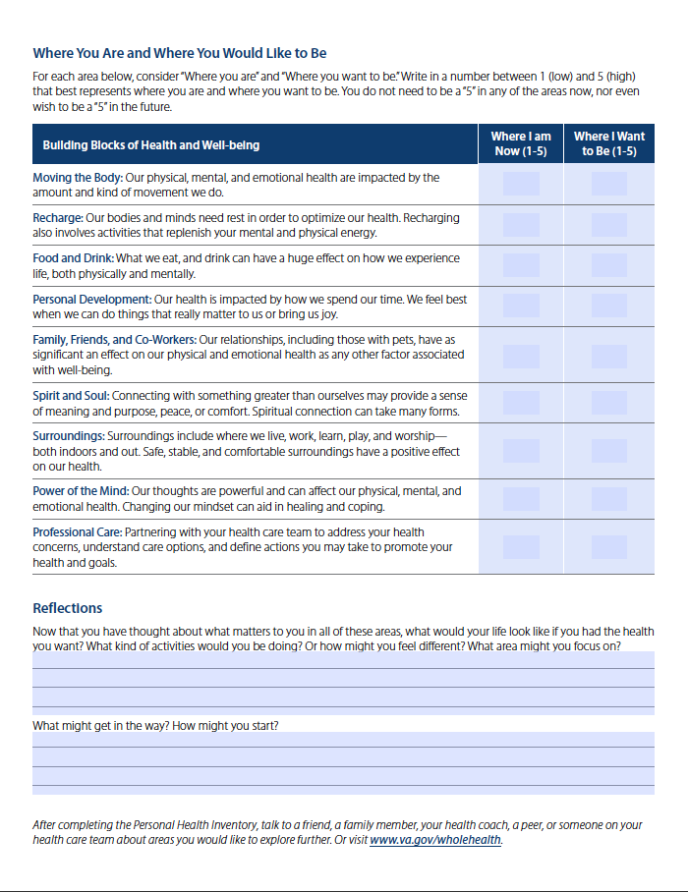
A Way to Know Ourselves
Personal Health Inventory
Personal Health Inventory (va.gov)

Slide 12


Need for Individual and Organizational Approaches to Health Professional Well-Being
Although studies demonstrate greater impact from positive health care organizational changes than individual self-care change, both are needed to ensure total well-being.
West CP, Dyrbye LN, Shanafelt TD. Physician burnout: contributors, consequences and solutions. Journal of Internal Medicine 2018;283(6): 516-529
Patel RS, Sekhri S, Bhimanadham NN, Imran S, Hossain S. A Review on Strategies to Manage Physician Burnout. Cureus. 2019;11(6):e4805. Published 2019 Jun 3. doi:10.7759/cureus.4805

Slide 13
System-Wide Approach
Environmental and Work System Factors
Individual Mediating Factors
Clinician Burnout
Clinician Well-being
or
Well-Being
Program
Tools
Consequences for clinicians, patients, health care organizations and society
National Academy of Medicine. Consensus Study Report Highlights. Taking action against clinician burnout: A systems approach to professional well-being. Oct. 2019.

Slide 14
Solutions to Avoid Burnout and Promote Well-Being
Health care systems need to make organizational changes to address administrative tasks and other burdens and provide resources (physical, psychological, spiritual)
We anticipate better results when combining individual self-care approaches with the system changes.
  Individual approaches include intensive lifestyle change, combined with positive psychology approaches.
    For example, in one study:
      Positive praise reduced emotional exhaustion
      Art therapy reduced overall stress and increased positive feelings
Patel UK, Zhang MH, Patel K, et al. Recommended strategies for physician burnout, a well-recognized escalating global crisis among neurologists. Journal of Clinical Neurology 2020;16(2):191-201.

Slide 15
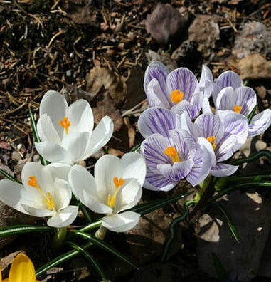
Coping vs. Resilience vs. Flourishing
Resilience goes beyond traditional coping
Flourishing goes beyond resilience
Stress management skills can help with coping and resilience, but not necessarily thriving and flourishing
Intensive healthy lifestyle, including positive activities, can support thriving and flourishing.

Slide 16
What is Positive Psychology?
Less emphasis
Human deficits and weaknesses
More emphasis
Human strengths
Improving well-being
Average to great
Fixing pathology
“The scientific study of positive human functioning and flourishing on multiple levels that include the biological, personal, relational, institutional, cultural, and global dimensions of life.”
—Seligman M, Csikszentmihalyi M, 2000
Seligman, Martin EP, Csikszentmihalyi, M. Positive Psychology: An Introduction. American Psychologist. (2000). 55(1):5-14.
Seligman M. Flourish: A Visionary New Understanding of Happiness and Well-being. New York, Free Press; 2011.

Slide 17
PERMA Model of Positive Psychology by Martin Seligman
  Positive emotion
  Engagement
  Relationships
  Meaning
  Achievement
Seligman M. PERMA and the building blocks of well-being. Journal of Positive Psychology 2018 doi.org/10.1080/17439760.2018.1437466

Slide 18
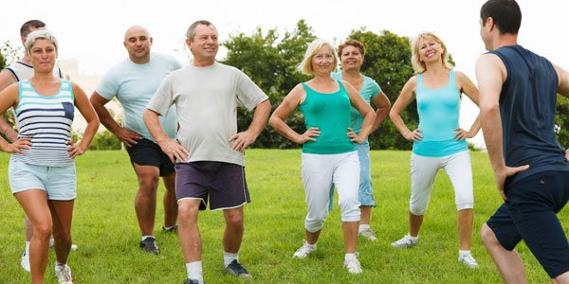


Reinforcing Link between
Healthy Lifestyle and Positive Emotion

Slide 19

Mediating Mechanisms:
Why Happier Individuals Live Longer?
Healthier behaviors
Cardiovascular health (parasympathetic influence)
Lower inflammation
Immune system strength
Longer telomeres
Better endocrine regulation
Kansky J, Diener E. Benefits of well-being: Health, social relationships, work, and resilience. Journal of Positive Psychology and Wellbeing 2017;1(2):129-169.

Slide 20
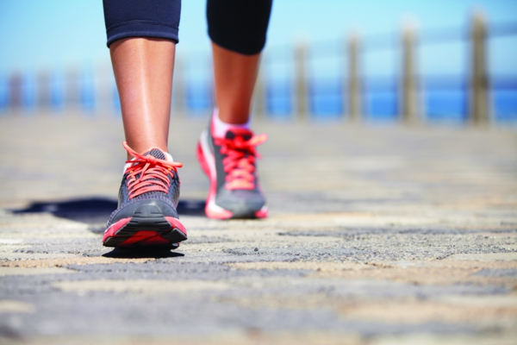
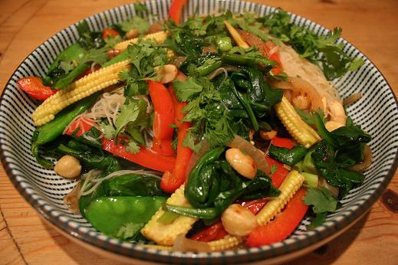
Health Behaviors of Happier People
Exercise
Don’t smoke
Use seat belts
Eat healthful and nourishing food
Avoid risky alcohol use
Kansky J, Diener E. Benefits of well-being: Health, social relationships, work and resilience.
Journal of Positive Psychology and Well-being 2017;1(2):129-169.

Slide 21

Stress Management
What is stress?
  A state of mental or emotional strain or tension resulting from adverse or very demanding circumstances. When most people report stress, they mean distress.
Distress can be managed with:
  Breathing; mind-body awareness and feedback
  Mindfulness
  Time outs/ frequent breaks/vacations
  Physical activity
  Cognitive behavioral techniques
  Positive psychology techniques

Slide 22
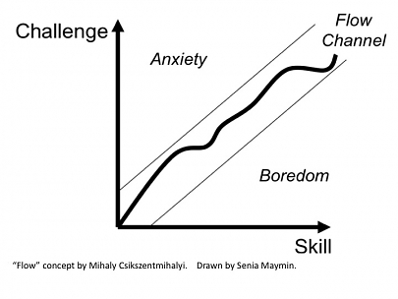

Eustress = Flow
Czikszentmihalyi M. Flow: The Psychology of Optimal Experience. New York, NY: Harper and Row, 1990.

Slide 23
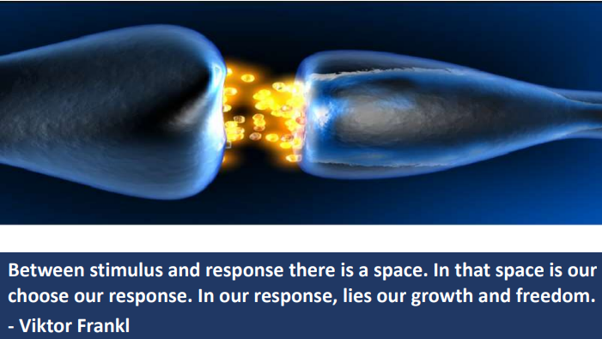

Slide 24
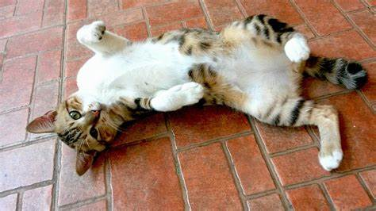
STRETCH AND BREAKS

Slide 25

Activity 2
  Apply positive psychology activities in personal action plans for emotional and physical well-being

Slide 26
Positive Psychology Framework: PERMA
Positive emotions
Engagement
P
E
R
A
Relationships
M
Achievement
Meaning

Slide 27
Positive Emotions
Hope, joy, gratitude, optimism, etc.
Can help physicians be more open-minded when diagnosing patients or creating action plans.
Improve vagal tone, associated with greater heart rate variability and physiologic benefits of pumping up the parasympathetic nervous system
P
E
R
A
M
One study: When physicians received (but did not eat) candy to stimulate positive emotions before reviewing case information, the physicians were quicker and more accurate at solving the case.
Kok BE, Coffey KA, Cohn MA, et al. How positive emotions build physical health: perceived positive social connections account for the upward spiral between positive emotions and vagal tone. Psychological Science 2013;24:1123-1132.
Estrada CA, Positive affect improves creative problem solving and influences reported sources of practice satisfaction in physicians. Motivation and Emotion 1994;18:285-299.

Slide 28

Positive Emotion and Healthy Lifestyle
The “upward spiral theory”
  States that pleasant, intrinsic, natural emotions increase nonconscious (natural) motivation and positive health behaviors
  Positive emotions build one’s psychological, social, and physical resources
Van Cappellen P, Rice EL, Catalino LI, et al. Positive affective processes underlie positive health behavior change. Psychol Health 2018;33(1):77-97.
Kok BE, Coffey KA, Cohn MA, t al. How positive emotions build positive health: perceived positive social connections account for the upward spiral between positive emotions and vagal tone. Psychological Science 2013;24(7):1123-1132

Slide 29
Engagement
Increases positive neurotransmitters and hormones
Elevates well-being and general health
Finding engagement/flow at work is positively related to health
P
E
R
A
M
Engagement in a “flow” state means finding enjoyment in an activity so much that you become completely engrossed in what you are doing or experiencing, losing track of time.
Czikszentmihalyi M. Flow: The Psychology of Optimal Experience. New York, NY: Harper and Row, 1990.

Slide 30
Relationships
People with strong social relationships have:
Less feelings of isolation
More hope and optimism
Higher self-efficacy
Greater well-being
More life satisfaction
Better health outcomes
Greater longevity
A longitudinal study (Harvard Adult Development Study, began in 1938 and still ongoing) found that positive social connection was the single most important factor associated with happiness, physical health, and longevity.
E
P
R
Vaillant G E. Triumphs of Experience: The Men of the Harvard Grant Study, Cambridge, MA: Belknap Press, An imprint of Harvard University Press. 2012
Vaillant GE. Aging Well: Surprising Guideposts to a Happier Life from the Landmark Study of Adult Development. New York, NY: Little, Brown and Spark, Hatchette Book Group, 2002.
Vaillant GE. Adaptation to Life. Cambridge, MA: Harvard University Press, 1998.
https://www.adultdevelopmenttsudy.org
A
M

Slide 31
Meaning
People are happier at work when they find meaning in their work and outside of work.
Meaningful activities outside of work could also contributes to work-life balance.
E
P
R
A
M
Meaning can promote:
Productivity and success at work
Positive relationships and life fulfillment
Positive mental health and well-being
Lower risk of cognitive decline and disability
Longevity
Roepke AM, Jayawickreme E, Riffle OM. Meaning and health: A systemic review. Appl Res Qual Life. 2014;9(4):1055-1079.
Boyle PA, Barnes LL, Buchman AS, et al. Purpose in life is associated with mortality among community-dwelling older persons. Psychosomatic Medicine. 2009; 71:574-579
Boyle PA, Buchman AS, Bares LL, Bennett DA. Effect of a purpose in life on risk of incident Alzheimer Disease and mild cognitive impairment in community-dwelling older adults. Archives of General Psychiatry. 2010;67:304-310

Slide 32

The Healing Power of Purpose
Meaning and purpose are good for us in many ways!
Lowers mortality
It decreases risk of death as much as it is increased by tobacco use, poor diet, inactivity, or high stress levels
Reduces stroke, heart attack, Alzheimer’s
Improves sleep, mood, sex life, mental health
Increases success of staying substance free, seeking prevention
↑ HDL, ↓ inflammation
Ramps up DNA repair

Slide 33
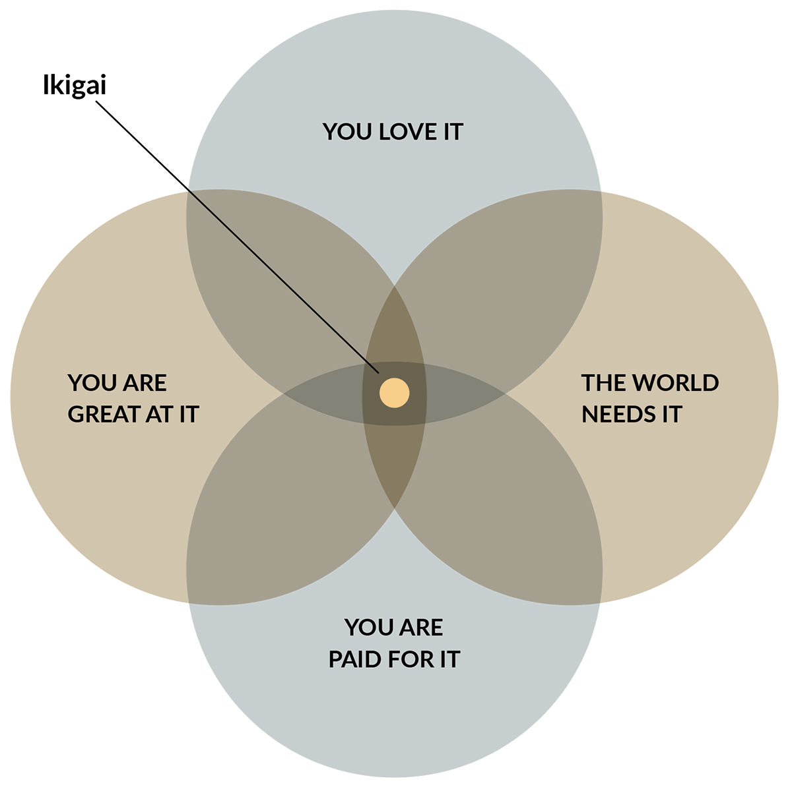
Ikigai
What is it?
How do you find yours?
https://positivepsychology.com/

Slide 34
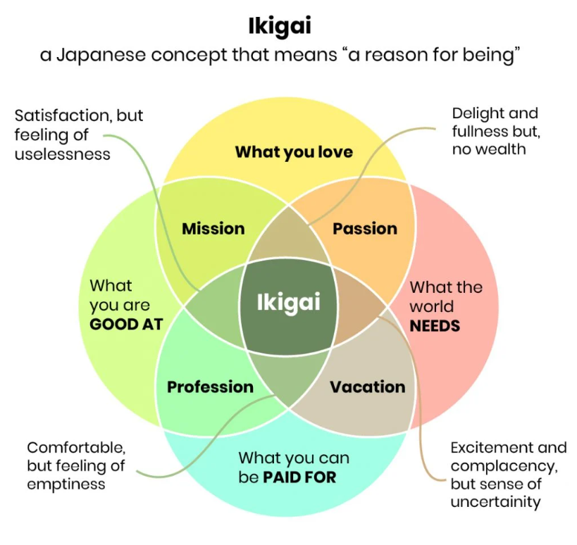
Ikigai
What is it?
How do you find yours?
https://positivepsychology.com/

Slide 35
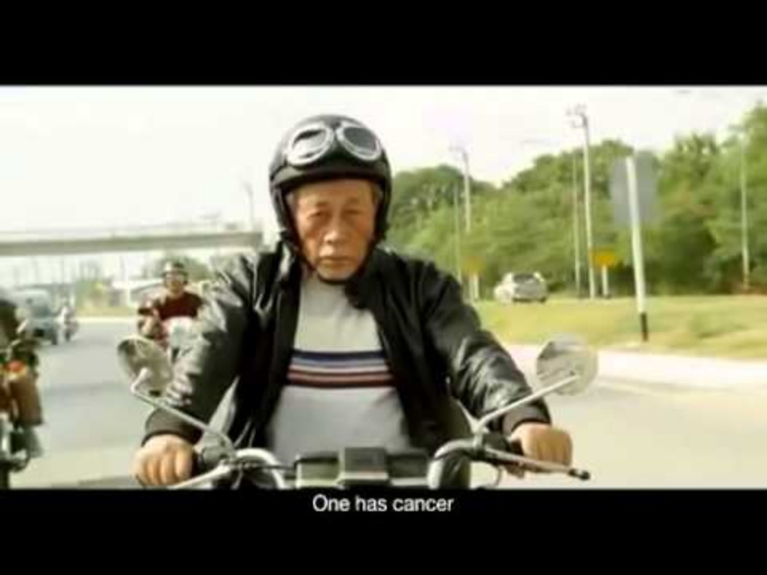

Slide 36
A Way to Know Ourselves
Personal Health Inventory
Personal Health Inventory (va.gov)

Slide 37
Achievement
Feelings of achievement increase:
Self-esteem
Self-efficacy
Self-mastery
Resilience, especially during challenges
Perseverance
People possess a need to be strong & competent and strive to achieve those needs.
Feelings of accomplishment or achievement arise when using skills and making an effort in ways that leads to successful results.
E
P
R
A
M

Slide 38
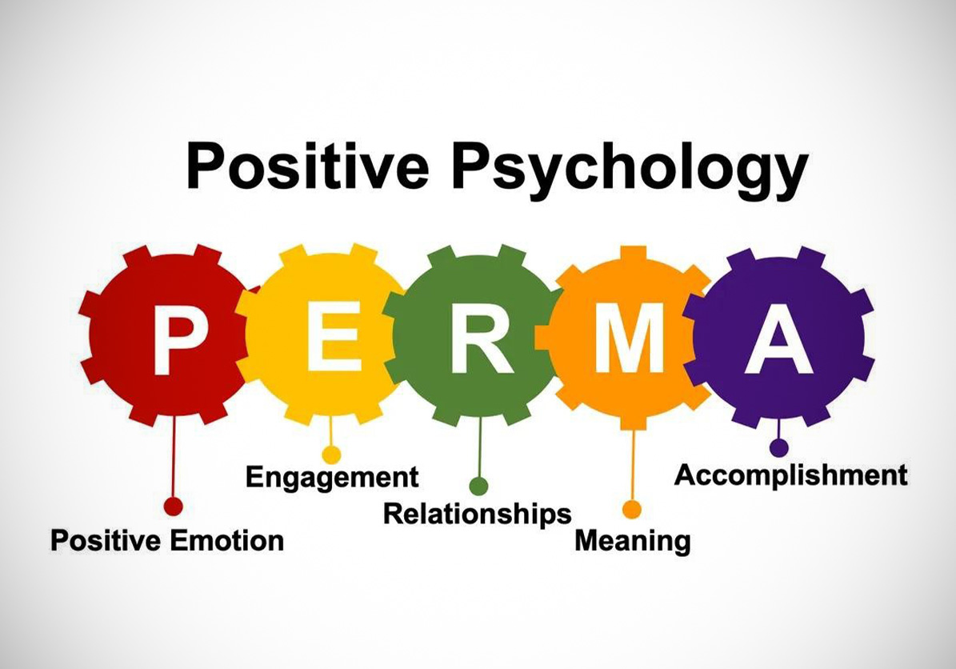
What are some of your Positive Psychology-Based Activities

Slide 39

Examples of Positive Psychology-Based Activities
Random acts of kindness
Focus on what’s good
Gratitude journaling, gratitude jar or gratitude connections
Mindfulness/meditation
Using character strengths
Positive Reminiscence
ggia.berkeley.edu provides instructions on many activities

Slide 40

Well-Being Is Boosted When in
Proximity to Nature!
Meta-analysis of 103 observational & 40 interventional studies: increased greenspace exposure associated with decreased cortisol, diastolic blood pressure, HDL cholesterol, and improved HRV; also decreased type 2 diabetes, CVD mortality, and all cause mortality
A single 90 min. walk in natural setting versus an urban setting: decrease in rumination (often found in persons with depression and other mental illness)
A 16 min walk (=/- 5 min) with improved physiologic mechanisms: reductions in diastolic blood pressure, heart rate, cortisol levels
Bratman GN, Daily GC, Levy BJ, et al. Benefits of nature experience: Improved affect and cognition Landscape and Urban Planning 2015;138:41-50
Park BJ, Tsunetsugu Y, Kasetani T, et al. The physiological effects of shinrinyoku (taking in the forest atmosphere of forest bathing): evidence form field experiments in 24 forests across Japan. Environ Health Prev Med. 2010;15(1):18-26.
Twohig-Bennett C, Jones A. Health benefits of the great outdoors: A systematic review and meta-analysis of greenspace exposure and health outcomes. Environ Res. 2018;166:628-637.

Slide 41
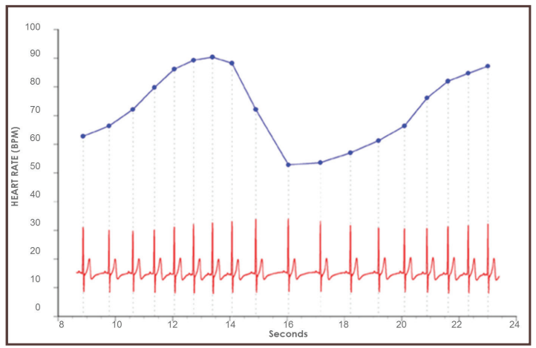
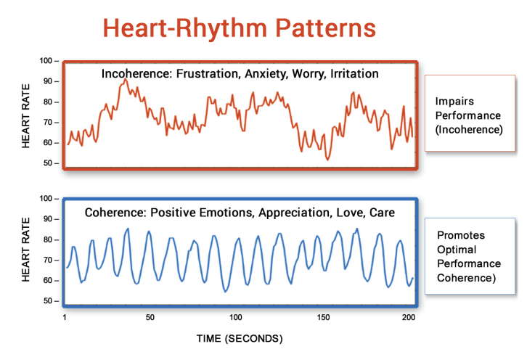
Heart Coherence and HRV
Heart rate variability (HRV) is a measure of the normally occurring beat-to-beat changes in heart rate. These fluctuations in heart rate result from complex, nonlinear interactions among several different physiological systems. HRV is an Indicator of Self-Regulatory Capacity, Autonomic Function and Health.
When we are stressed, the body is out of sync. The depleting emotions we feel, like anger, frustration, anxiety, and worry, lead to disorder in the nervous system.
Renewing emotions like appreciation, care, and kindness create order, which is called coherence. Coherence leads to mental clarity, creativity, and resiliency.

Slide 42
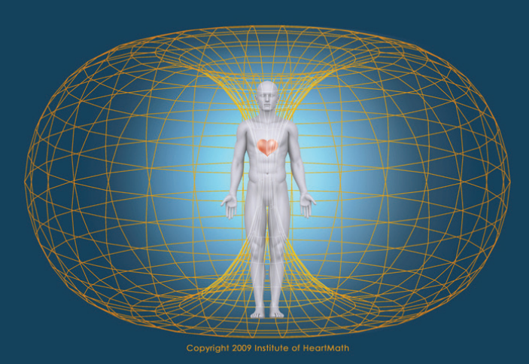
Heart Coherence and HRV
“Since emotional processes can work faster than the mind, it takes a power stronger than the mind to bend perception, override emotional circuitry, and provide us with intuitive feeling instead. It takes the power of the heart.”
– Doc Childre, HeartMath Institute founder
The heart’s magnetic field, which is the strongest rhythmic field produced by the human body, not only envelops every cell of the body, but also extends out in all directions into the space around us. The heart’s magnetic field can be measured several feet away from the body by sensitive magnetometers.

Slide 43

Shift and Lift technique
1. Heart-Focused Breathing
2. Activate
3. Radiate

Slide 44
Key Points
A healthy lifestyle has self care circles of health : physical activity, plant-based diet, sleep, avoiding risky substance use, stress management, and positive activities in PERMA.
PERMA stands for? positive emotion, engagement, positive relationships, meaning, and accomplishment. These are the main elements of positive psychology that improve emotional well-being and lead to flourishing.
Positive emotion and healthy habits have a reinforcing, reciprocal relationship.
Time in nature supports our physical and emotional well-being.
You can build a self-care plan that harnesses all of these elements.

Slide 45
Positive Health and Well-Being Resources
Benson Henry Institute for Mind Body Medicine: massgeneral.org/bhi/
Global Positive Health Institute: positivehealth.world
The Greater Good Science Center: ggsc.berkeley.edu
Greater Good in Action: ggia.berkeley.edu
International Positive Psychology Association: ippanetwork.org
Stanford University - Center for Compassion and Altruism Research and Education: ccare.Stanford.edu
University of Pennsylvania - Positive Psychology Center: ppc.sas.upenn.edu
Yale University - Center for Emotional Intelligence: ei.yale.edu
positivepsychology.com

Slide 46

STRETCH AND BREAKS

Slide 47
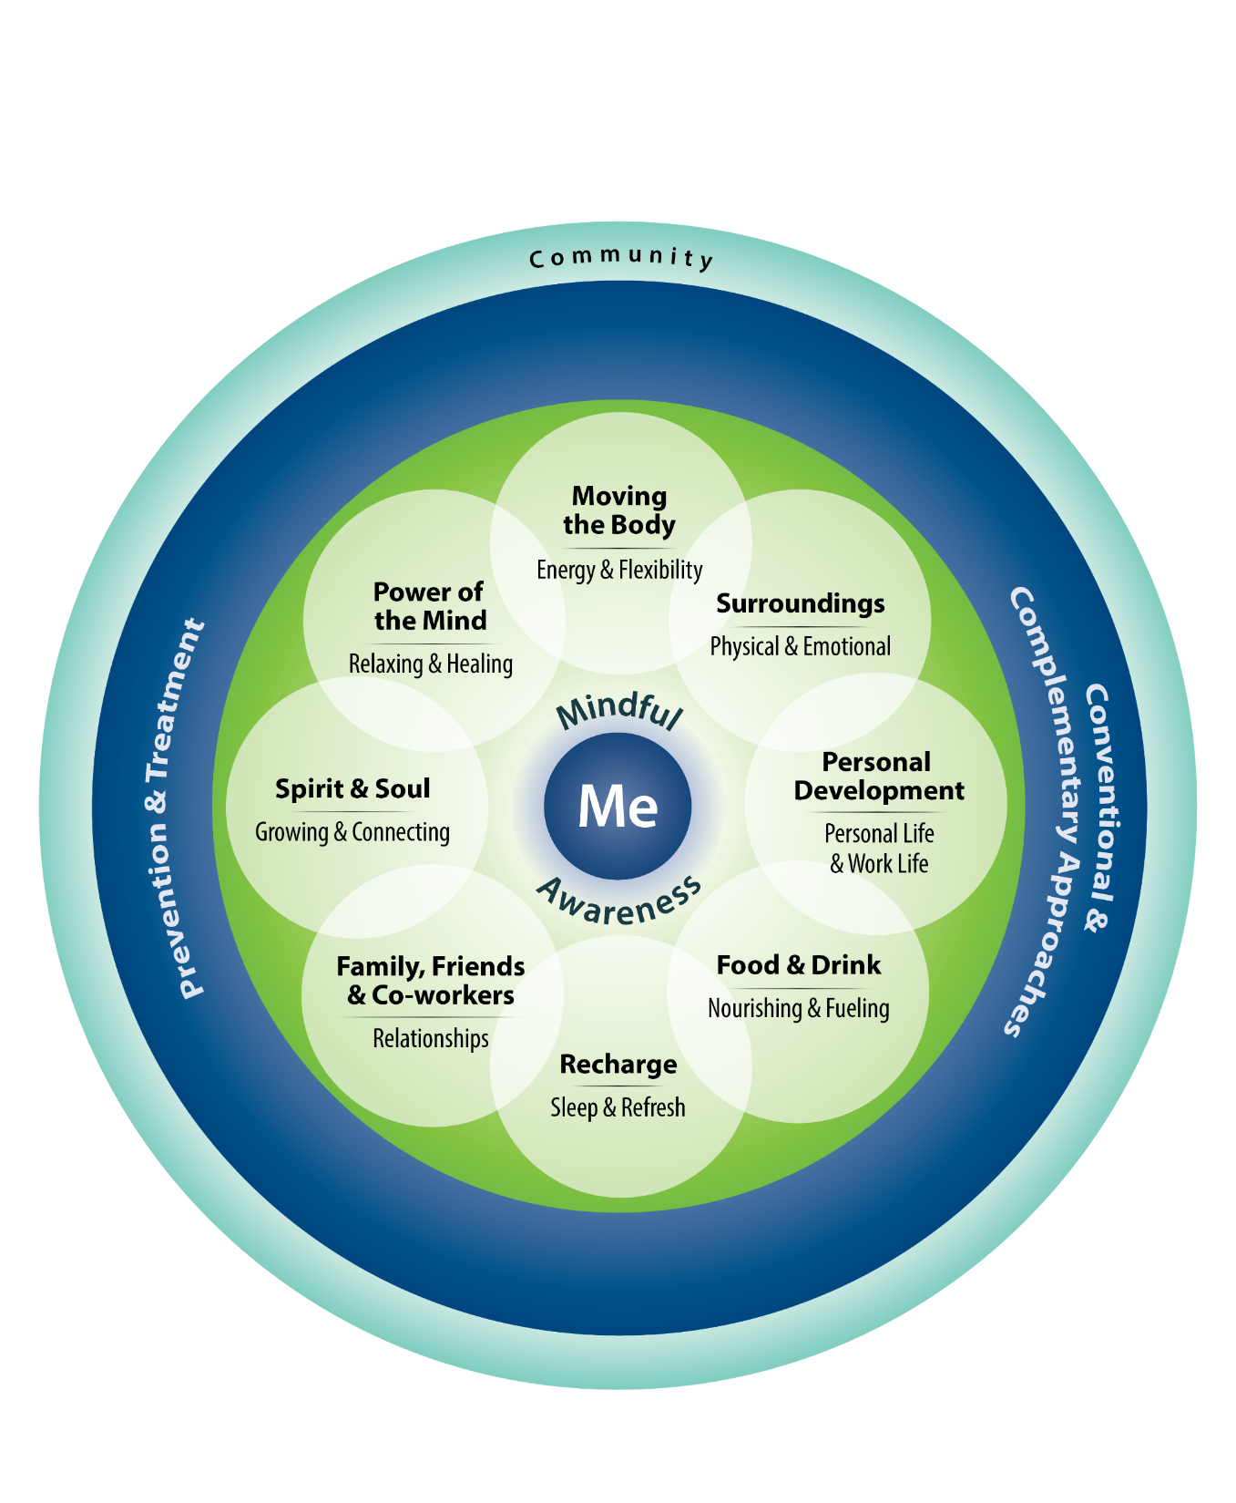
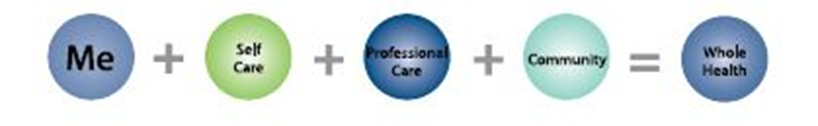

Slide 48
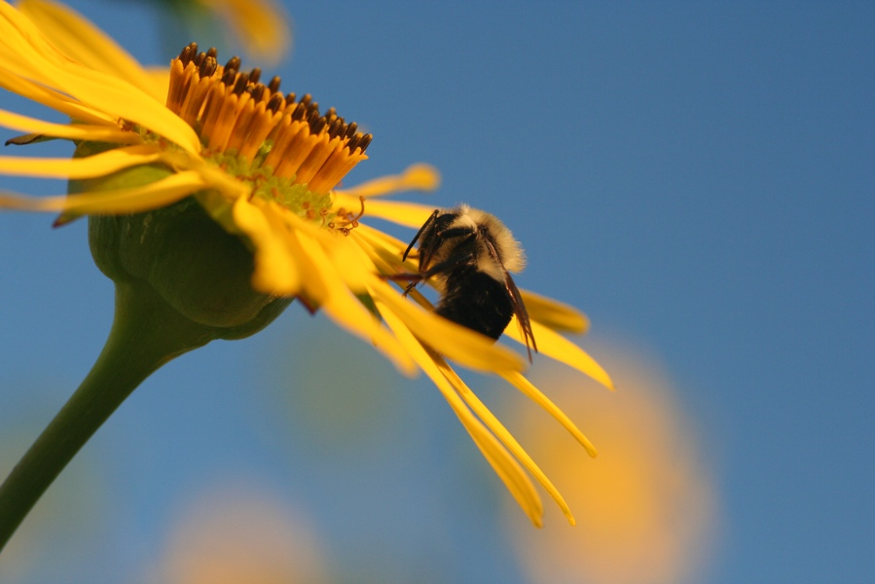
Mindful Awareness
A way of being…
in the present moment….
on purpose….
without judgment
Jon Kabat-Zinn

Slide 49

Mindfulness in Clinical Practice and Self-Care
Clinicians with a regular mindfulness practice enjoy reduced:
These Clinicians also experienced improvements in:
Stress response
Perseveration
Physical illness
Depression
Anxiety
Burnout
Perceived empathy
Patient adherence
Patient outcomes
Reduced medical errors
Shapiro SL, Schwartz GER, Bonner G. Effects of mindfulness-based stress reduction on medical and premedical students. Journal of Behavioral Medicine 2017;21(6):581-99.
Irving JA, Dobkin PL, Jeeson P. Cultivating mindfulness in health care professionals: A review of empirical studies of mindfulness-based stress reduction (MBSR). Complementary Therapies in Clinical Practice 2009;15:61-66.
Beach MC, et al A multicenter study of physician mindfulness and health care quality. Ann Fam Med. 2013;11(5):421-428.

Slide 50
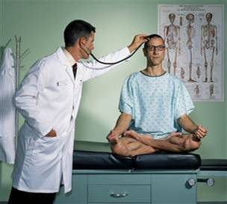
Suggestions: Mindful Awareness at Work
Pause for a moment before every interaction
    Threshold exercise
    A few deep breaths
    While cleaning your hands
Use a stethoscope or other object as a reminder
    Sitting in a chair or shaking hands can also remind you
Join a group to practice
    Some teams do mindfulness before they start the day
Try other daily practices
    You will experience several during this course
Other ideas?

Slide 51
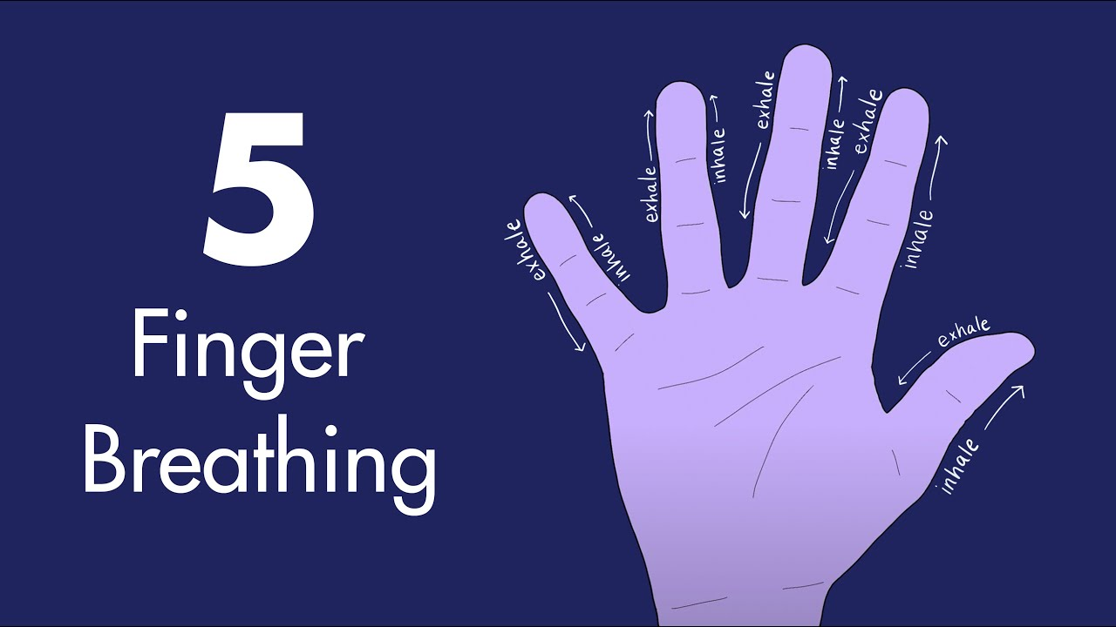
Five Finger Breathing

Slide 52
4-7-8 Breathing
HOLD
7
counts
IN (nose)
4
counts
OUT (mouth)
8
counts

Slide 53

Activities

Slide 54
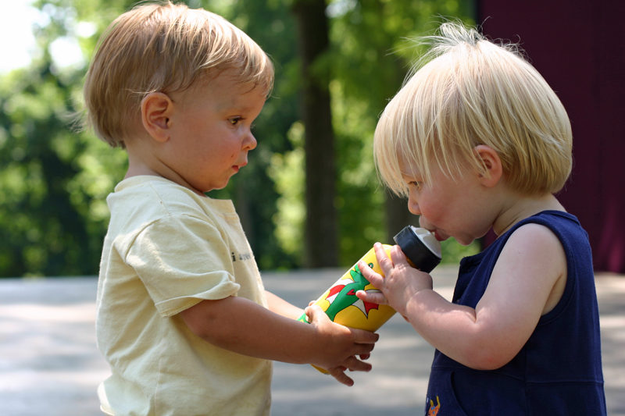
Acts of Kindness Exercise
Email or text an offer of assistance to a family member or friend after this workshop.
Do 4 more acts of kindness later today or tomorrow.

Slide 55




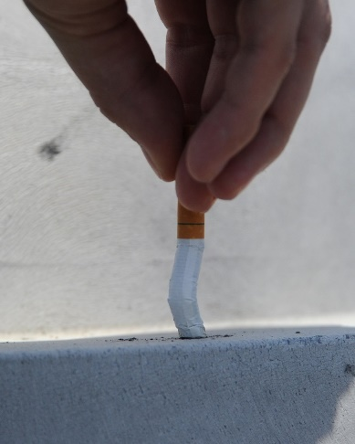
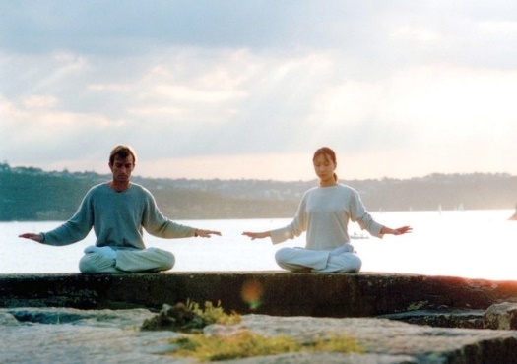
Self Care Action Plan Part 1 - Review Your Current
Self Care Activities
What do you do in each healthy lifestyle pillar?
  Physical activity
  Nutrition
  Sleep
  Risky substances avoidance
  Stress management
  Positive activities (PERMA)

Slide 56
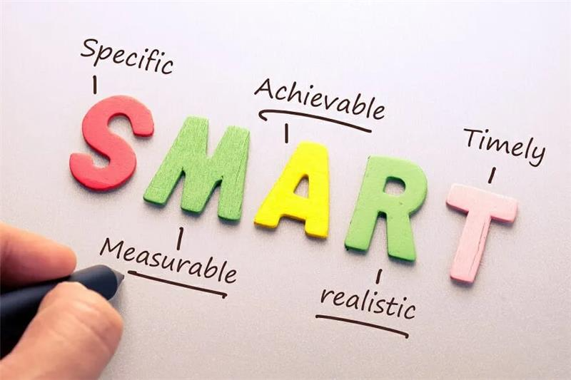
Set Goals That Matter
Set SMART (specific, measurable, action oriented, realistic, and time bound) goals
Set goals that are intrinsically meaningful, and match your values and passions
“By pursuing work, education, and relationships that yield both meaning and pleasure, we become progressively happier—experiencing not just an ephemeral high that withers with the leaves but lasting happiness with deep stable roots.”
These slides are very busy with too much clutter, and it is challenging to find the meaningful details in that.
Tal Ben-Shahar
Aghera A, Emer M, Bounds R, et al. A randomized trial of SMART goal enhanced debriefing after simulation to promote educational actions. West J Emerg Med. 2018;19(1):112-120.
Ben-Shahar T. Happier New York City, NY: McGraw-Hill Education, 2007, p 139.

Slide 57
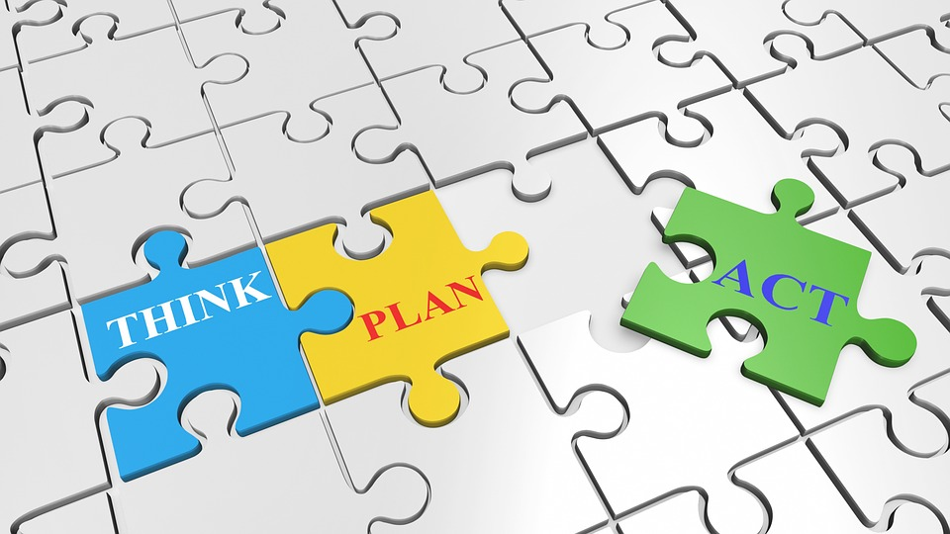
Self Care Action Plan – Part 2
Identify the right balance of self care activities for your life
Consider one priority area in self care
Choose an activity to improve that priority area
Write an action plan. Start with at least one step of the action plan: What? When? How often? For how long? Where? With Whom?
© HealthType LLC and Global Positive Health Institute, Inc.

Slide 58

Self-Care Action Plan- Part 3
What will you do?
When?
How often?
For how long?
With whom?

Slide 59
How Can You Use PERMA for Your Well-Being?
P: What can you do to increase positive emotions in yourself?
E: What “flow” activities can you do regularly?
R: What relationships can add positivity resonance to your life? What can you do to increase positive interactions?
M: What activities are meaningful to you and how can you include them in your professional and personal life?
A: What goals can you pursue that align with your values and passions and that you can achieve successfully?

Slide 60
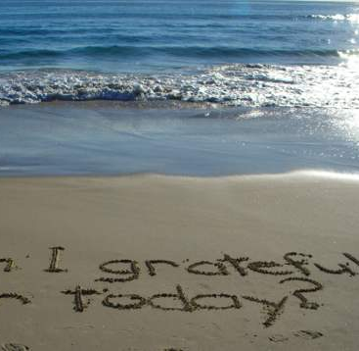


Activity 2
  Develop individual action steps in achieving and sustaining a comprehensive healthy lifestyle, including eating a whole food plant-based diet, being physically active, and engaging in positive psychology activities

Slide 61
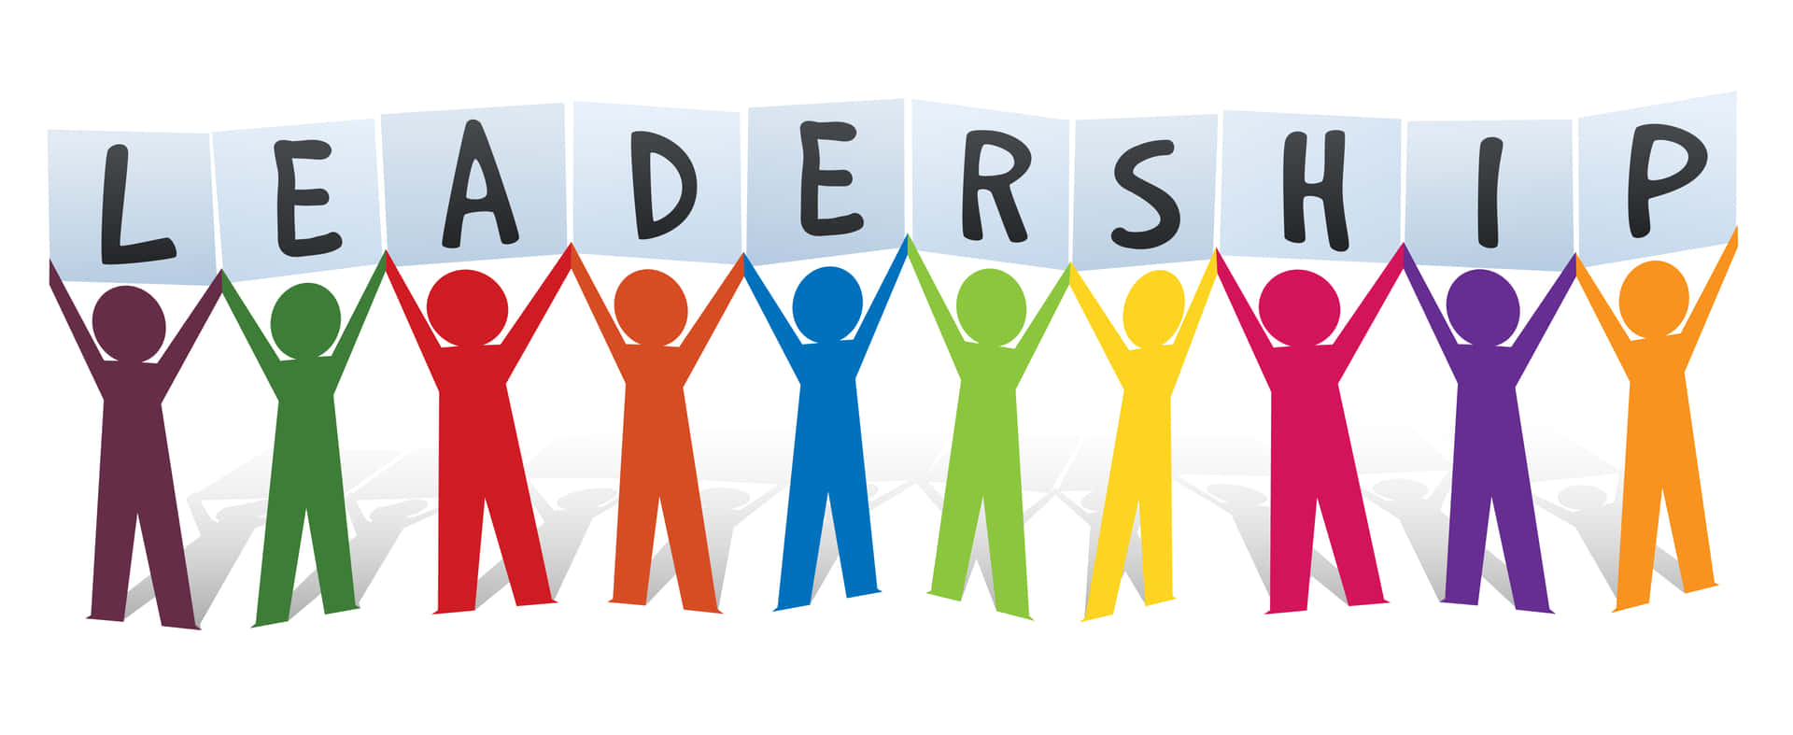
Adopt strategies for influencing health care workplace culture to support the well-being of health teams

Slide 62
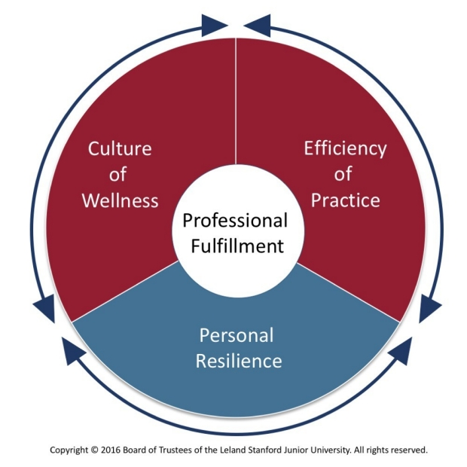
Initial Influence: Stanford Model of Professional Fulfillment™ (SMPF)
SMPF was developed to showcase that professional fulfillment and burnout mitigation requires organization-wide change
The framework illustrates that well-being is driven by individual personal resilience and through an organization’s dedication to fostering a culture
of wellness and efficiency of practice

Slide 63
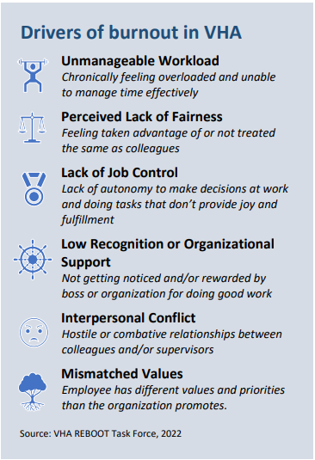
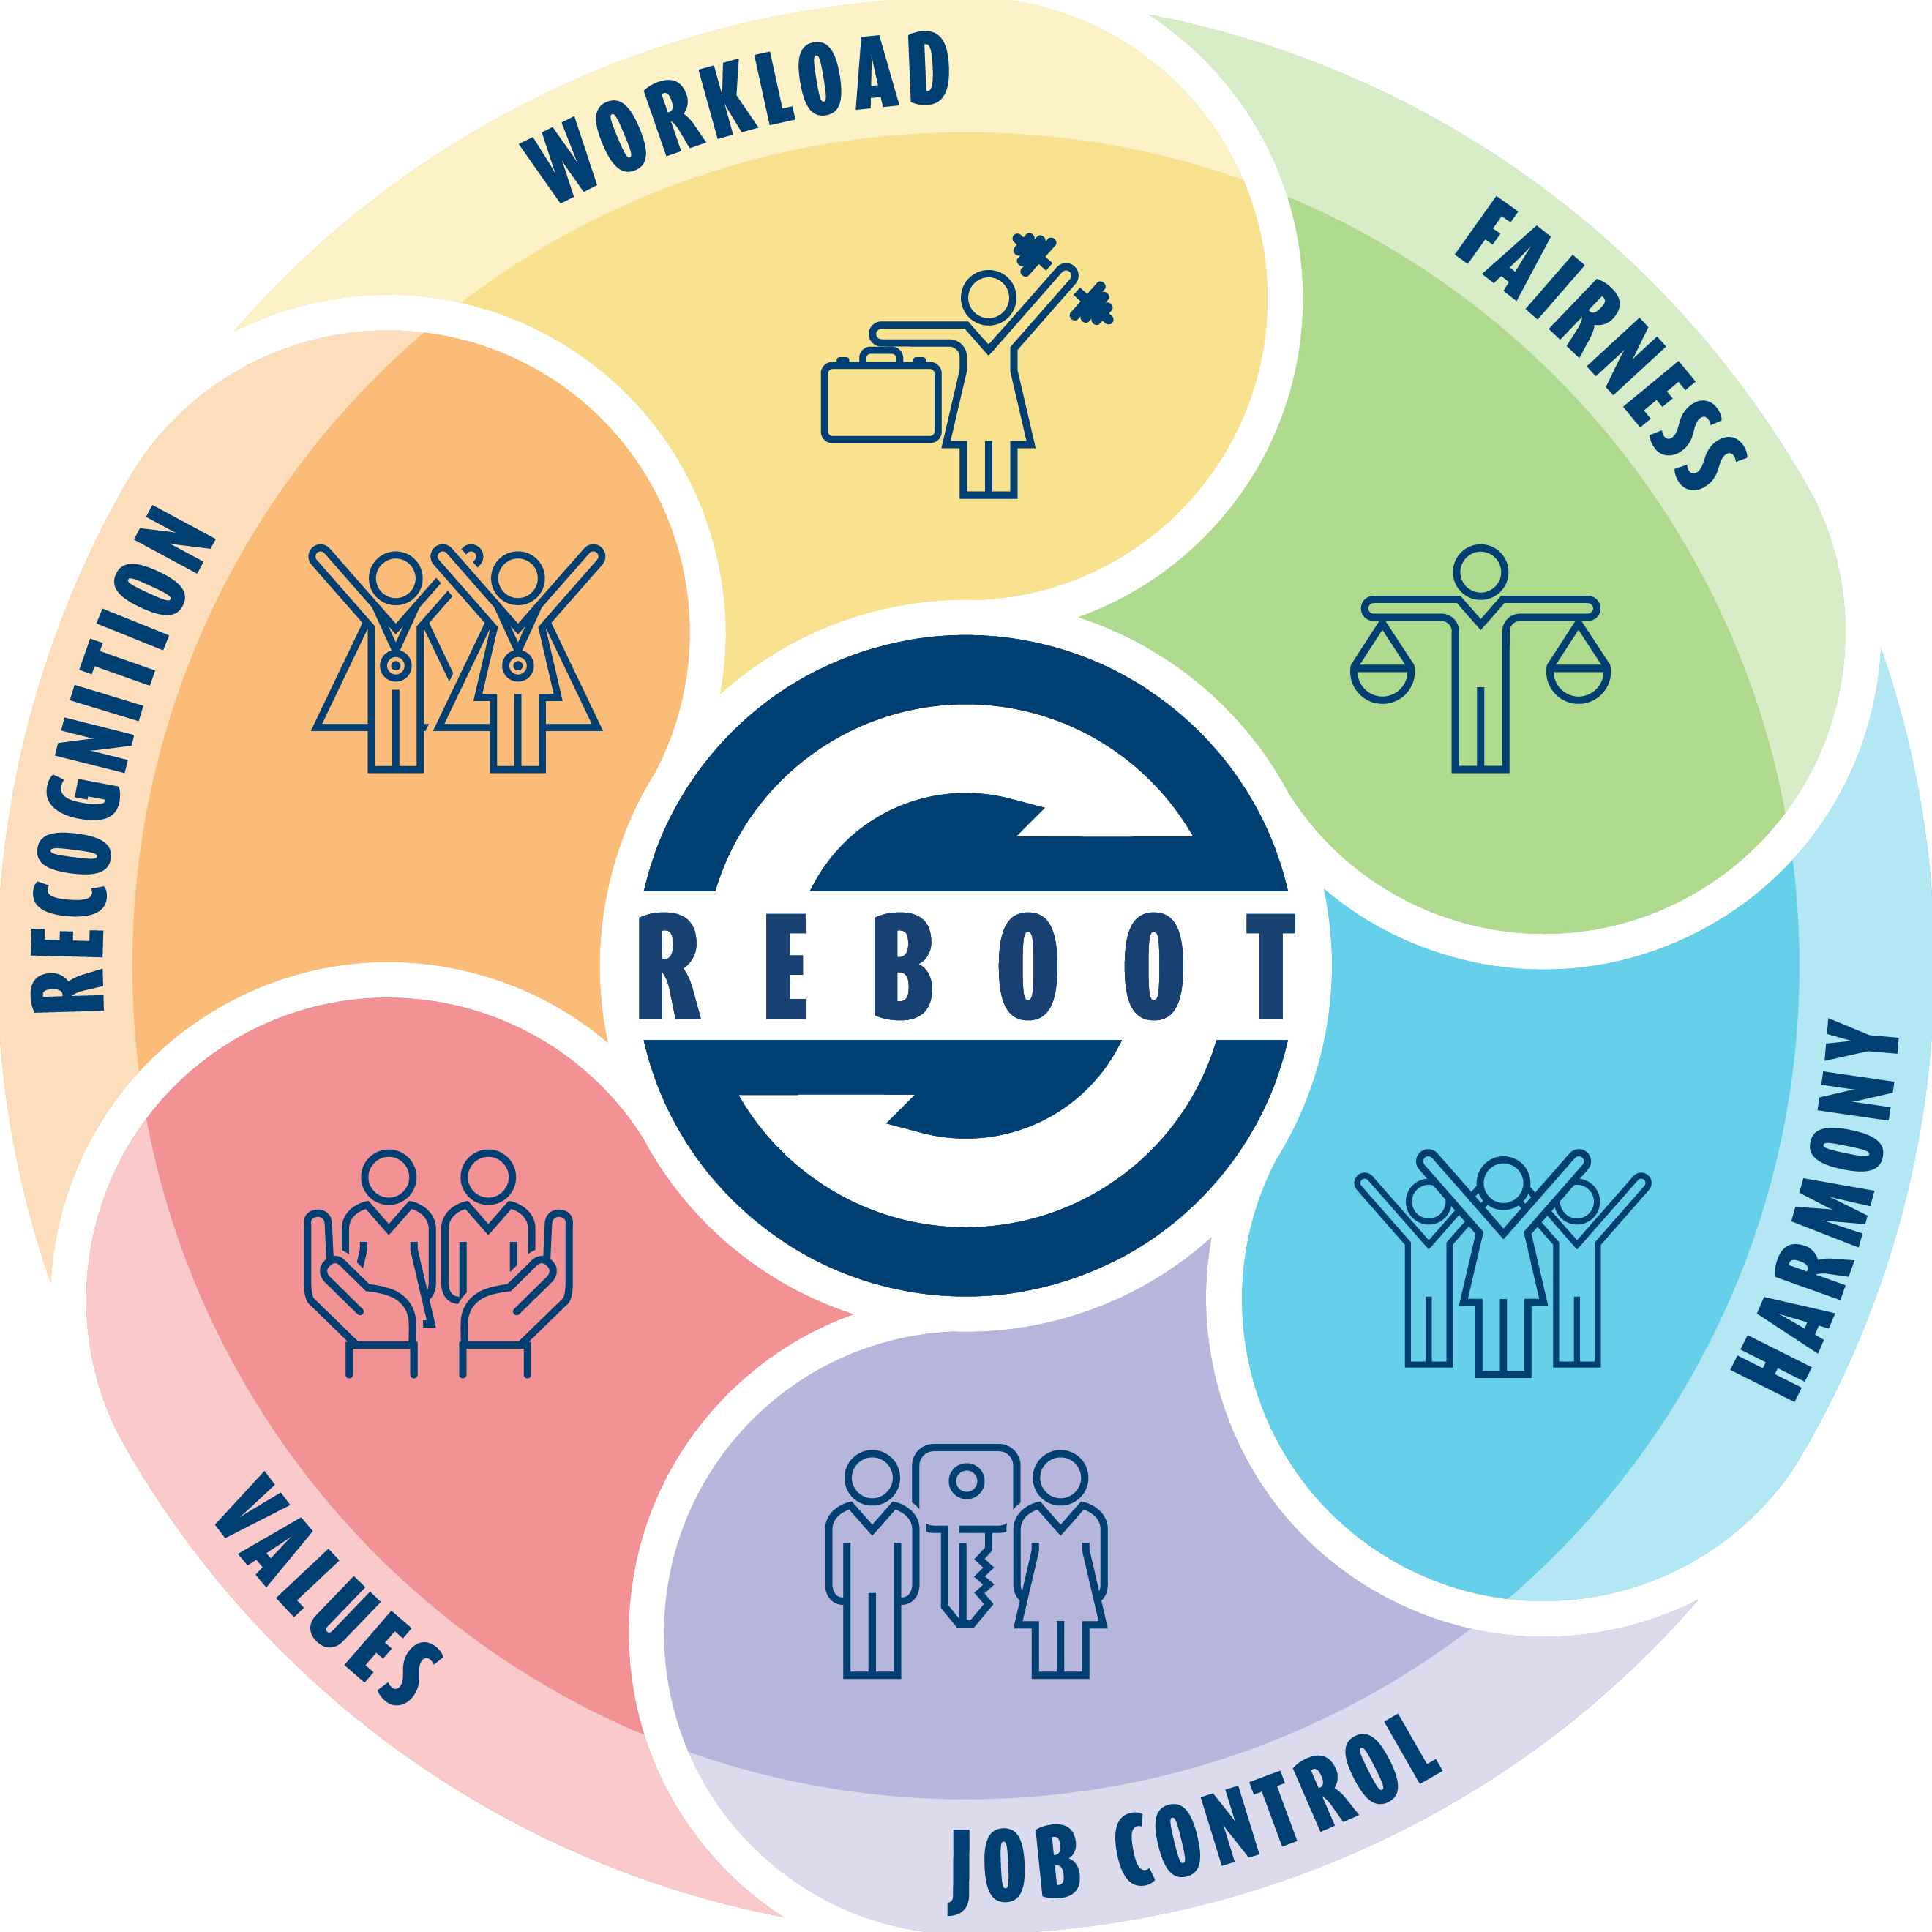
Reduce Employee Burnout and Optimize Organizational Thriving
The graphic above represents the six focus areas REBOOT is addressing by improving the work environment and support for employee wellbeing. These focus areas are workload, fairness, harmony, job control, values and recognition.

Slide 64
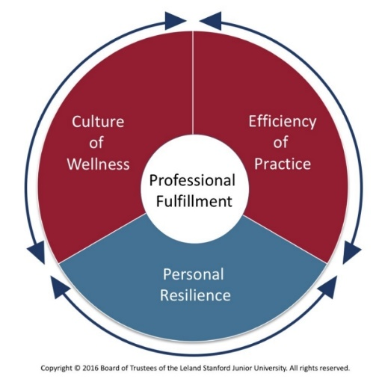







The Way Forward: Aligning REBOOT Actions with SMPF Dimensions
Personal Resiliency
Efficiency of Practice
Culture of Wellness
Implement Chief
Well-Being Officer
Strengthen Mental Health Support
Optimize Meeting Practices
Strengthen Culture of Servant Leadership
Address
Inefficiencies
Maximize Use of HR Policies/Flexibilities
CWO Program
Education | Community | Evaluation
Optimize TMS Training

Slide 65
Culture of Well-Being
Organization
Facility
Team Leader
Individual

Slide 66



Sphere of concern
Sphere of influence
Sphere of control

Slide 67
What are some ideas to improve workplace culture that can promote wellbeing?
  Strategies that promote personal and professional well-being are most effective.

Slide 68
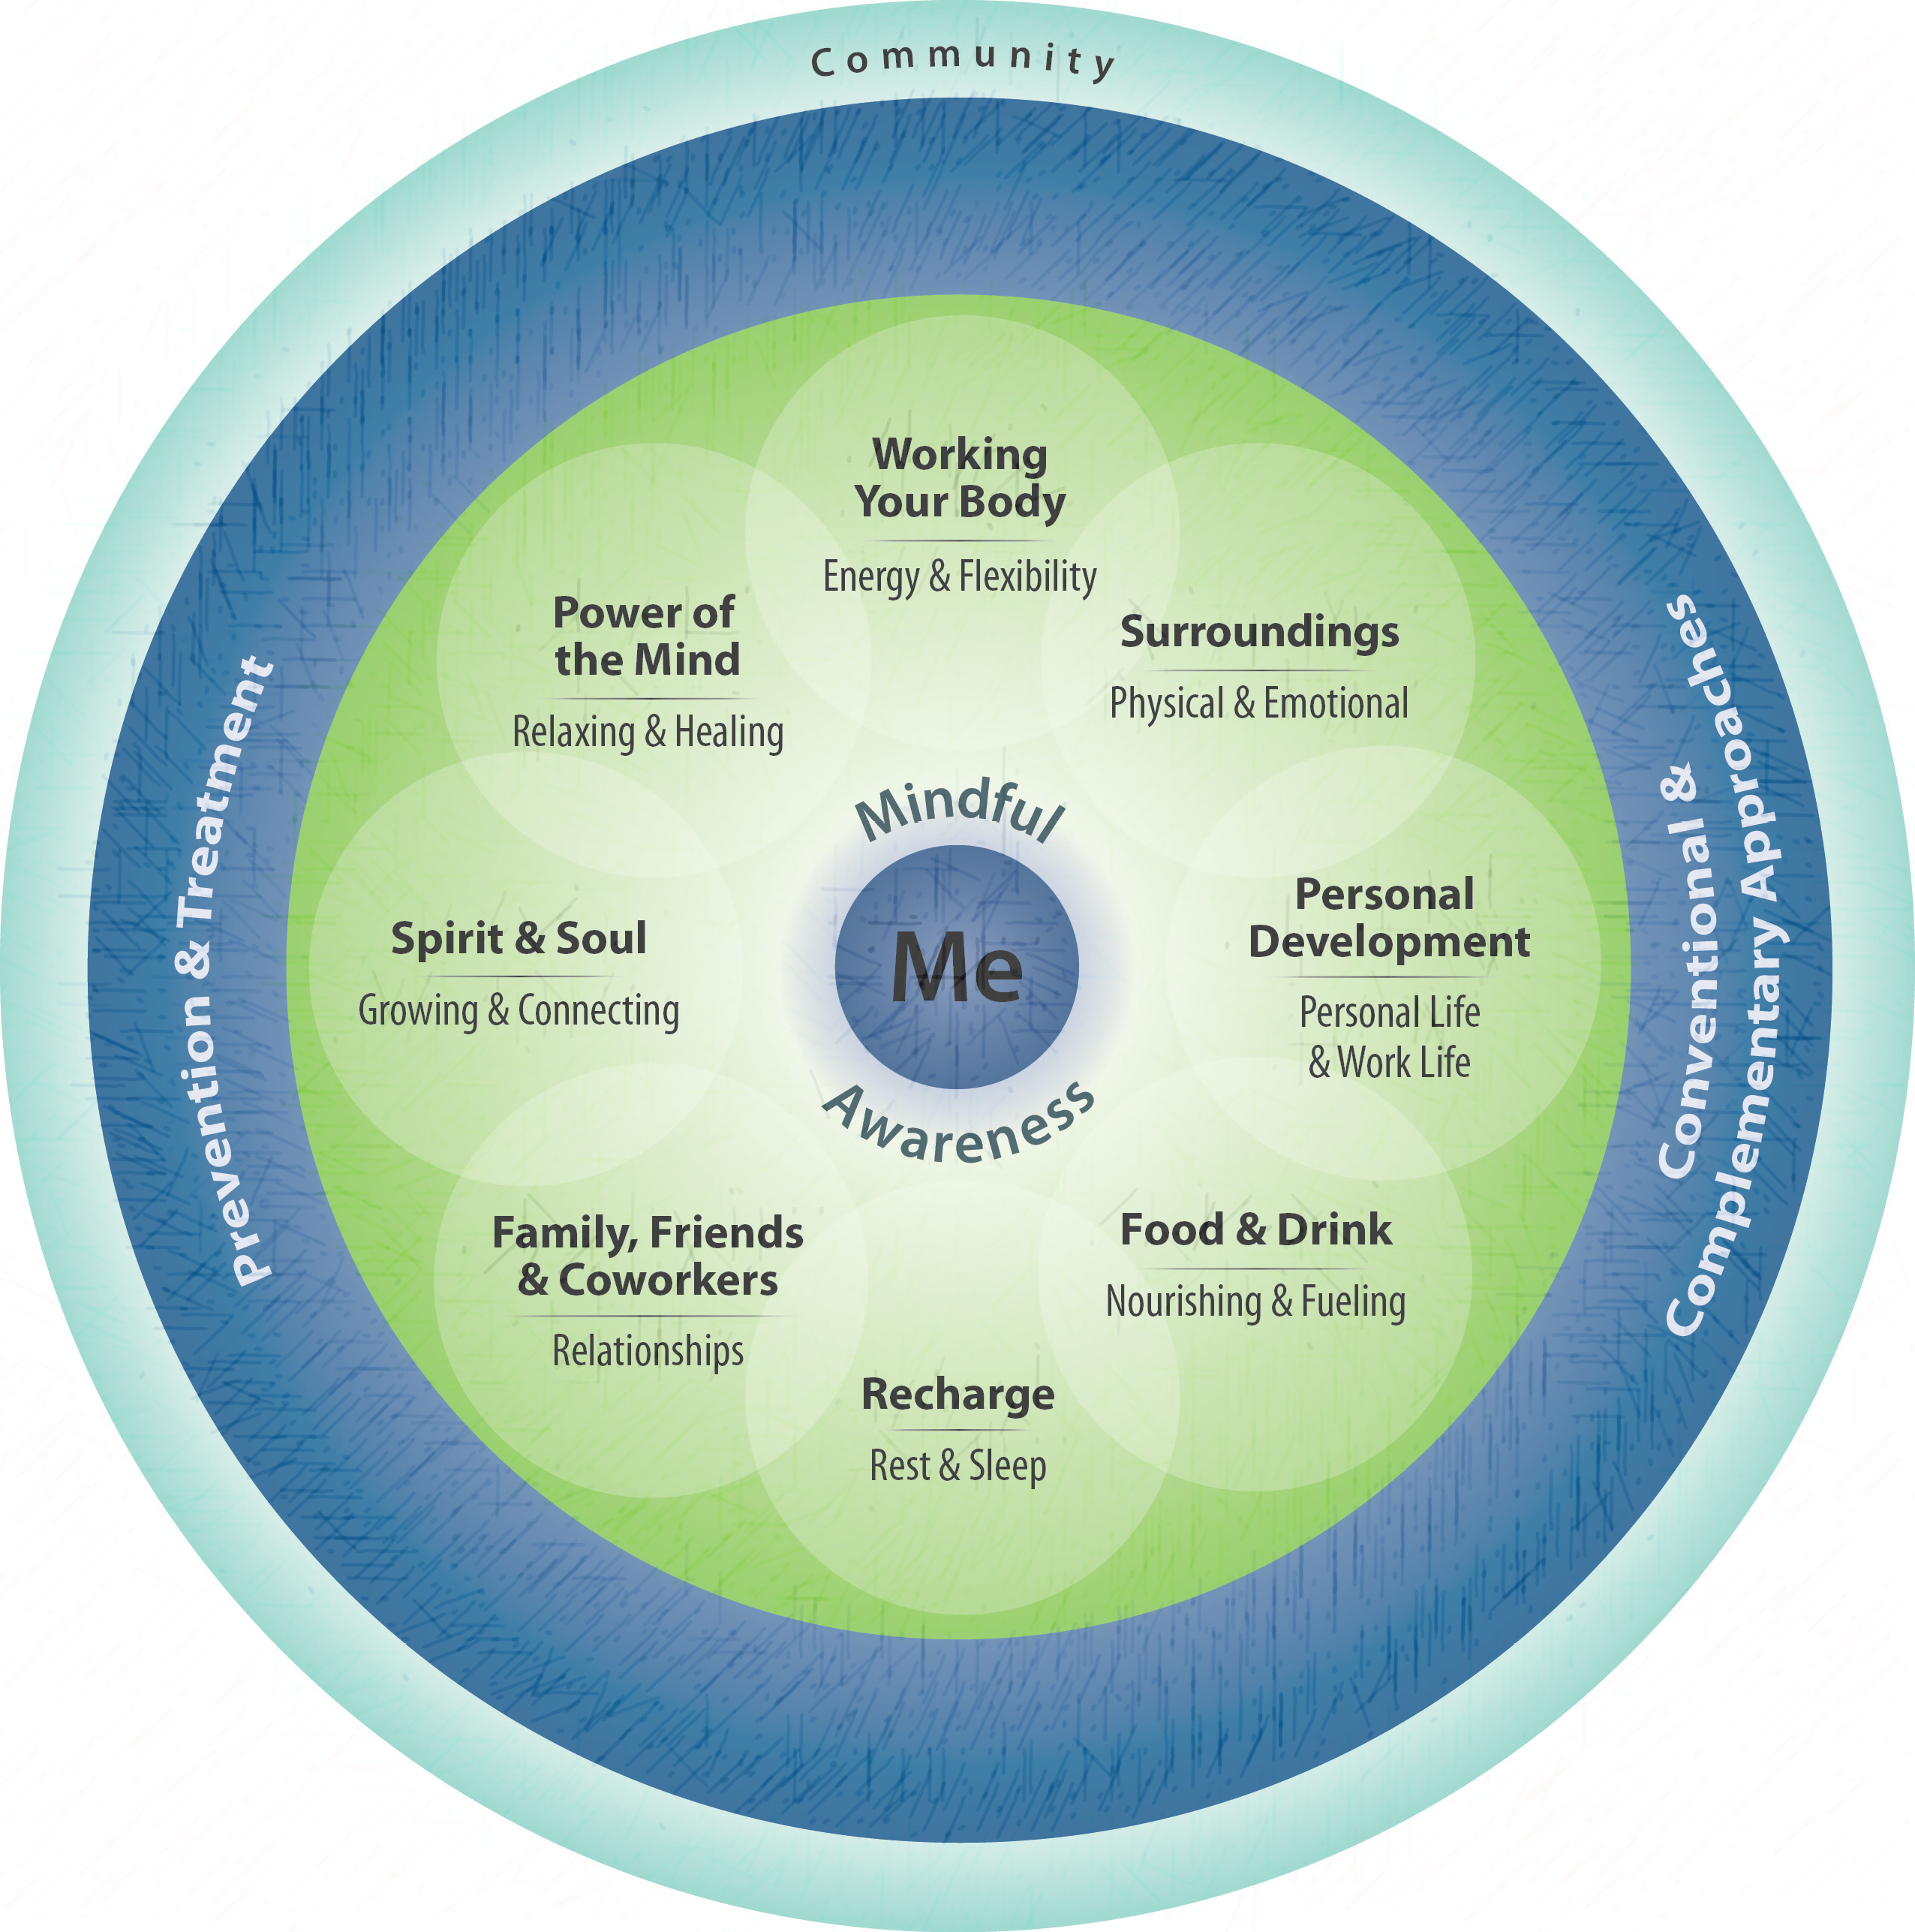
Evidence/Outcomes from the Literature
A meta-analysis of return-on-investment (ROI) studies of workplace wellness programs found that medical costs fall by about $3.27 for every dollar spent on wellness programs and that
absenteeism costs fall by about $2.73 for every dollar spent. Baicker et al. Health Affairs. 2010; 29:2.
Evidence from health care systems specifically indicate that healthcare professionals’ poor well-being and moderate to high levels of burnout are associated with poor patient safety outcomes such as medical errors. Hall et al. PLoS ONE. 2016; 11:7.
More recent focus is on value-of-investment (VOI) taking into account broader range of important outcomes for organizations as they relate to wellness program participation including impacts on employee engagement, absenteeism, burnout, job satisfaction and turnover.
Ozminkowski et al. Population Health Management. 2016; 19:4.
Evidence shows that employee attitudes regarding value of wellness programs and perceived organizational support (POS) for wellness is associated with participation. Those with greater wellness participation were found to have higher performance ratings, higher job satisfaction, higher intention to stay and lower turnover. Ott-Holland et al. J of Occup Health Psychol. 2019; 24:1.

Slide 69
Workplace Cultures that Promote Wellbeing
  Recognition of personal wellness as foundational
  Collaboration and supporting one’s co-workers is acknowledged and valued
  Protection of work day boundaries
  Collaborative leadership
  Transparent communication
  Trusting, positive interactions
  Strategies that promote personal and professional well-being are most effective.
Patel RS, Sekhri S, Bhimanadham NN, Imran S, Hossain S. A Review on Strategies to Manage Physician Burnout. Cureus. 2019;11(6):e4805. Published 2019 Jun 3. doi:10.7759/cureus.4805
Mastroianni K, Storberg-Walker J. Do work relationships matter? Characteristics of workplace interactions that enhance or detract from employee perceptions of well-being and health behaviors. Health Psychol Behav Med. 2014;2(1):798–819. doi:10.1080/21642850.2014.933343
Shanafelt TD, Noseworth JH. Executive Leadership and Physician Well-being: Nine Organizational Strategies to Promote Engagement and Reduce Burnout. 2017;92(1):129–146.
Swensen S, Kabcenell A, Shanafelt T. Physician-Organization Collaboration Reduces Physician Burnout and Promotes Engagement: The Mayo Clinic Experience. J Healthc Manag. 2016;61(2):105-27.
The American Psychological Association. Eds. Grawitch MJ, Ballard DW. The Psychologically Healthy Workplace: Building a Win–Win Environment for Organizations and Employees. 2016.

Slide 70
Organizational wellbeing
Key Points
Evidence-based organizational strategies can reduce burnout and increase individual and institutional well-being.
Key among these are:
  Positive, trusting, collaborative social interactions
  Collaborative, transparent leadership with effective two-way communication
  Personal action items and role-modeling to boost well-being in the workplace
You can use your leadership skills to promote, and role model these types of interactions.

Slide 71
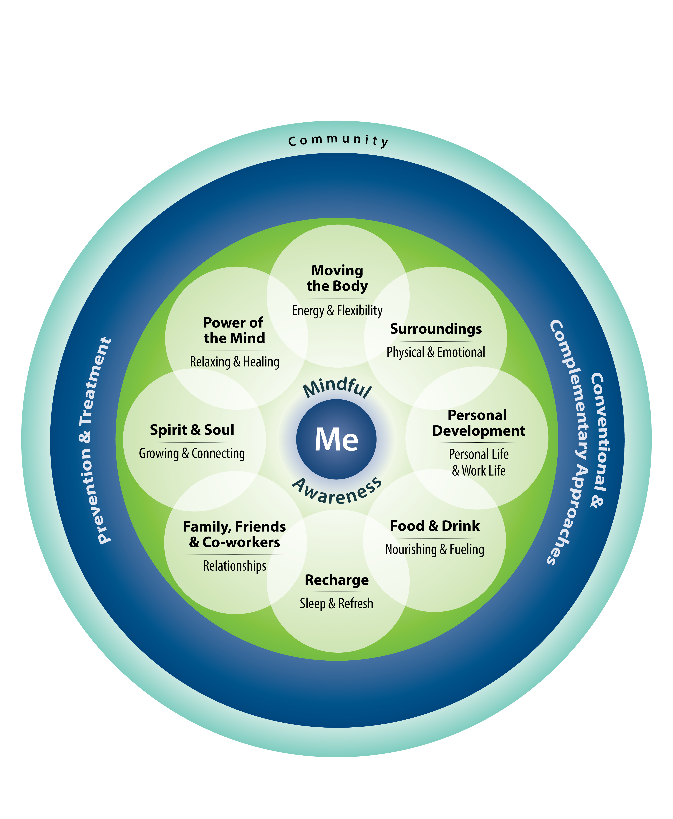
Self-Compassion
Decreases in self-valuation/Self-compassion correlated with sleep impairment, which has been linked to reduced performance in cognitive tasks such as sustained attention, decision making, and affect regulation. (Trockel et al 2019)
Mindfulness
Improvements in cortisol, sympathetic system reactivity, immune function (Heckenberg et al 2018)
Job Crafting- Meaning and Purpose
Improved engagement and reduced distraction when: (i) structure one’s tasks so that they can be done more effectively, or so that tedious tasks are no longer necessary, or so that more challenging or interesting tasks are available; (ii) improve one’s social relationships and interactions at work; and (iii) find meaning and purpose in the work being done, often by connecting it to the mission or vision of the entire organization itself. (Bialowolski et al 2020)
Gratitude
Brief gratitude tools (3 good things, Gratitude Letter , Looking Forward Tool) can be effective in improving emotional exhaustion, depression, subjective happiness, work-life balance, emotional thriving, and emotional recovery (Adair et al 2020)
Decrease Loneliness and Social Isolation
numerous effects on health and well-being outcomes including mortality risk, physical functioning limitations, happiness and life satisfaction, optimism, purpose in life, depression, and hope (Hong et al 2023)

Slide 72

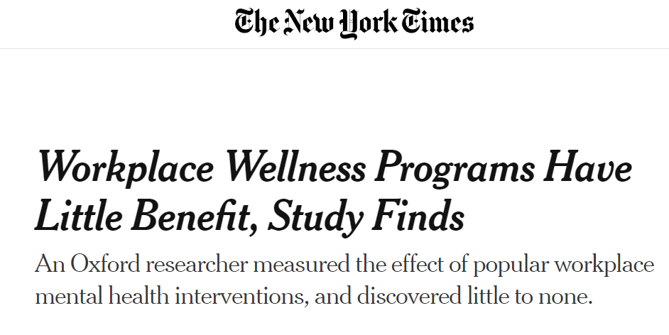
Well-Being in the Workplace
The Human Flourishng Program
Oxford Study: Employee Well-Being Outcomes from Individual Level Interventions

Slide 73

Wrap Up:
Which activities connected with you?
How can you use these activities during your workday? At home?
How can you use these activities in meetings?

Slide 74

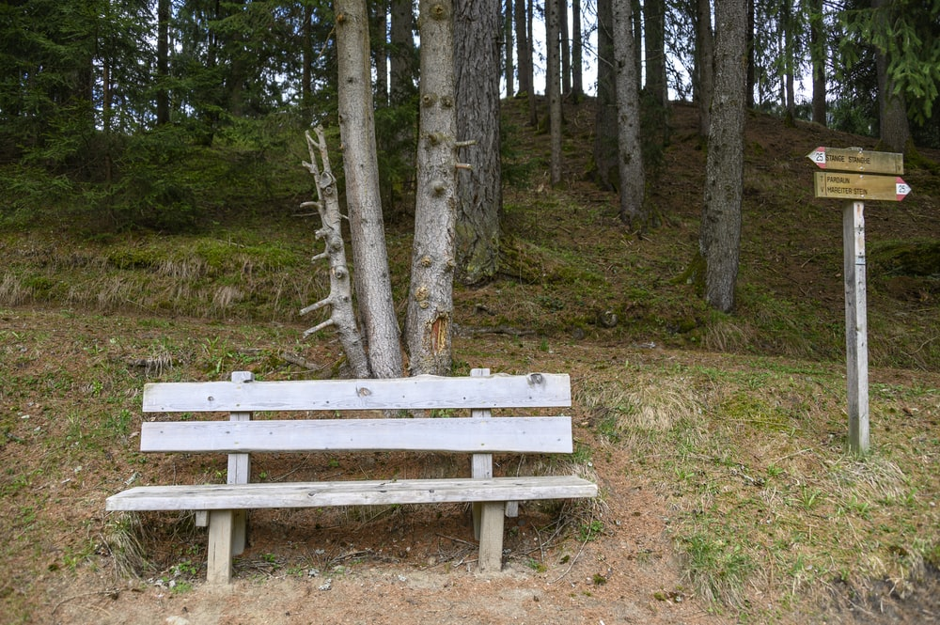
Time for a break.
MINDFUL AWARENESS

Slide 75

Sharing Gratitude
You are invited to share one of the things you are grateful for today.

